Slide 1
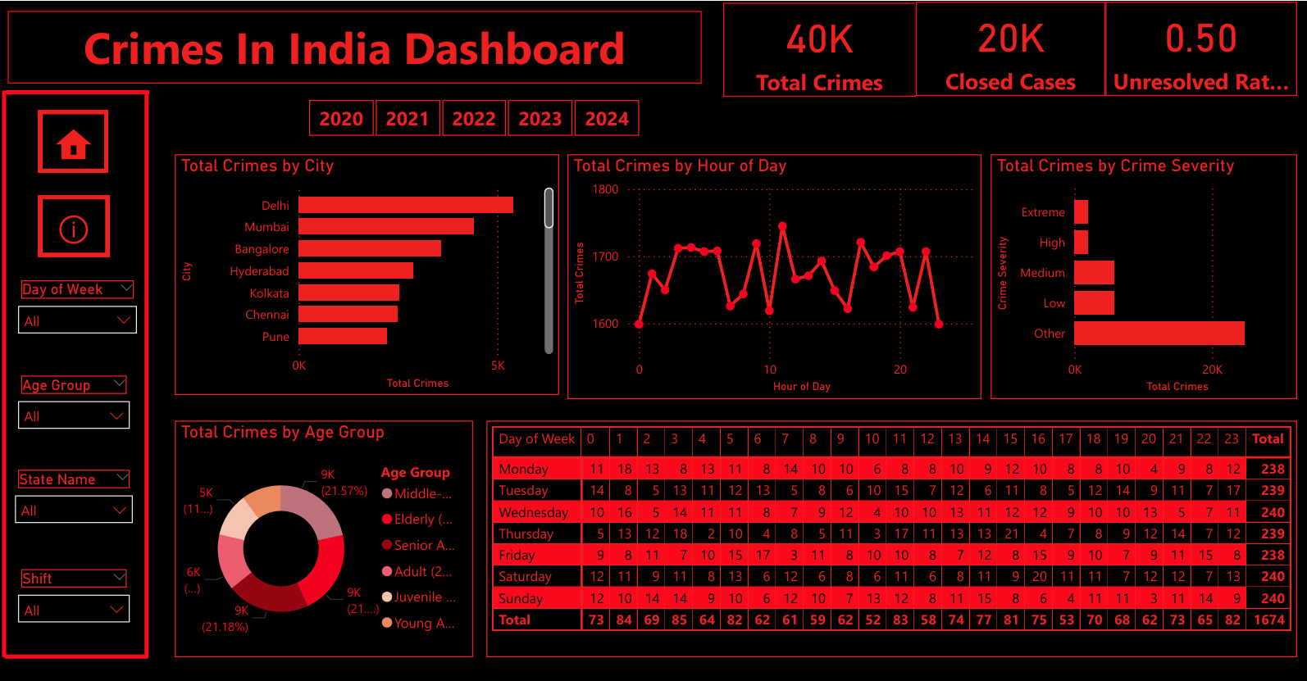
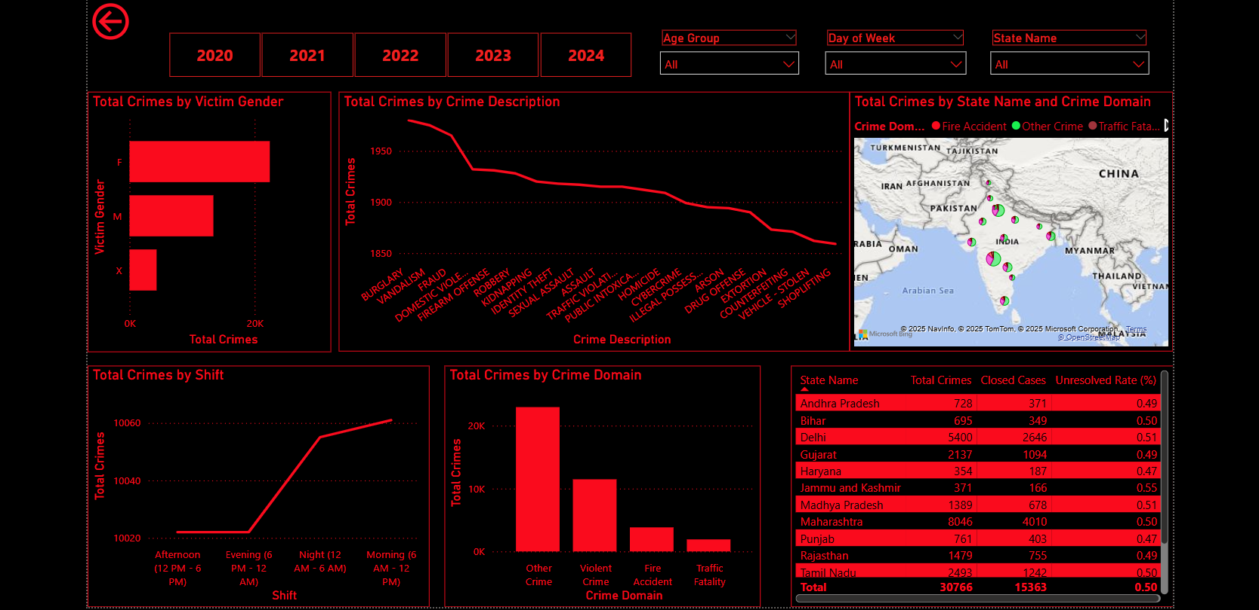
Crime in India Dashboard (2020–2024)
Prepared by: Shrawani Gongshe
Overview
Detailed

Slide 2
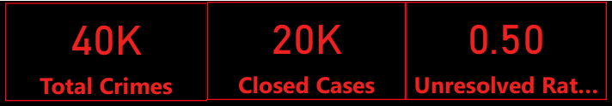
Dashboard Overview
Objective: Analyze crime statistics in India (2020-2024).
Key Metrics: - Total Crimes: 40K - Closed Cases: 20K - Unresolved Rate: 0.50
Tool: Power BI

Slide 3
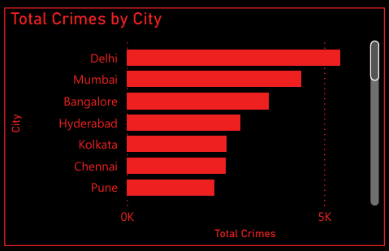
Crimes by City
Top Cities with Crimes: - Delhi - Mumbai - Bangalore Insight: Metropolitan areas like Delhi have the highest reported crimes.

Slide 4
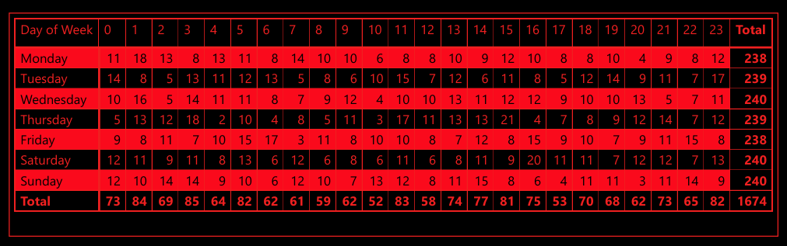
Crimes by Day of Week
Insight: Higher incidents on Thursday, Wednesday, and Sunday. Use Case: Optimizing police deployment on peak days.

Slide 5
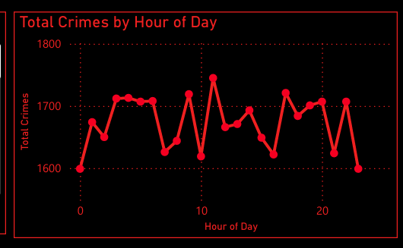
Crimes by Hour of Day
Insight: Evening hours (6 PM – 12 AM) see the most crime. Implication: Need for high-alert policing during late hours.

Slide 6
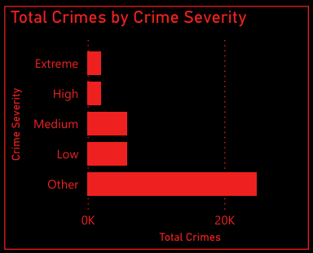
Crimes by Severity
Crime Categories: Extreme, High, Medium, Low, Other Insight: Most crimes fall under Medium to High severity.

Slide 7
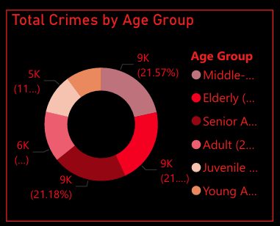
Crimes by Age Group
Age Categories: Adults, Young Adults, Juveniles, Elderly Insight: Adults and Young Adults form the largest victim group.

Slide 8
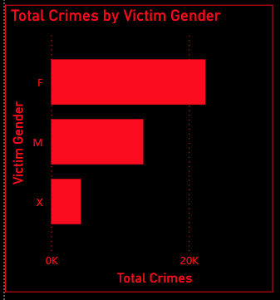
Crimes by Victim Gender
Gender: Male, Female, Other Insight: Males are more frequent victims, but crimes against females are high.

Slide 9
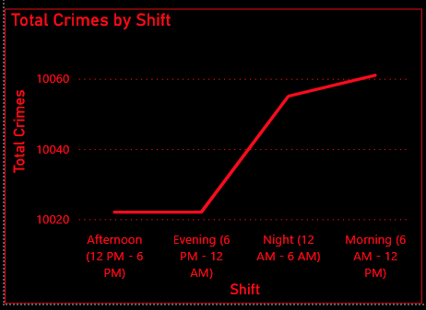
Crimes by Shift
Shifts: Morning, Afternoon, Evening, Night Insight: Afternoon and Evening shifts see peak crime rates.

Slide 10
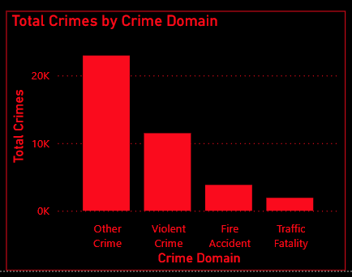
Crimes by Domain
Domains: Violent Crime, Fire Accident, Traffic Fatality, Other Insight: Violent and traffic-related crimes dominate.

Slide 11
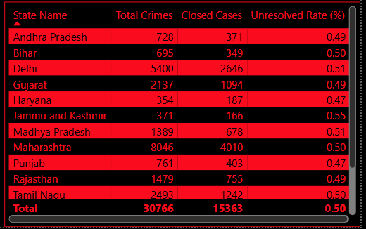
State-wise Crime Summary
Example: - Maharashtra: 8046 total crimes - Delhi: 5400 total crimes Average closure rate: ~50% across states.

Slide 12
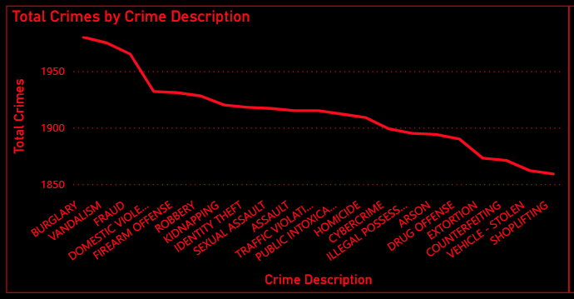
Crimes by Description
Top Crime Types: - Burglary - Robbery - Assault - Cybercrime Insight: Urban and digital crimes are prevalent.

Slide 13
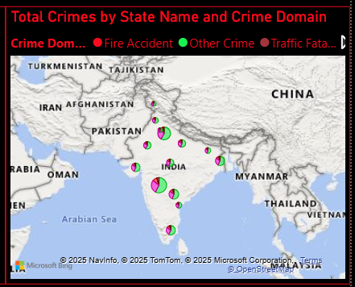
Map of Crimes by Domain
Insight: Visual spread across states showing hotspots for specific domains like violent crime or traffic fatalities.

Slide 14
Recommendations
- Increase surveillance in peak crime hours - Prioritize high-crime cities - Improve case closure rates - Gender and age-targeted safety programs

Slide 15
Conclusion
Crime trends show variation by city, time, and demographic. Power BI offers actionable insights for policy and enforcement.

